Slide 1
Rahman Ismail Sr. Software Architect
USB 3.0 Overview

Slide 2
Agenda
What is USB 3.0
Connectors/cables
Physical Layer
Link Layer
Protocol Layer
Power Management
Summary

Slide 3
USB 3.0 Features
10x performance increase over USB 2.0
Backward compatible
Legacy devices continue to work when plugged into new host connector
New devices work when plugged in legacy systems albeit at USB 2.0 speeds
Existing class drivers continue to work
Same USB Device Model
Pipe Model
USB Framework
Transfer types
Power Efficient
Provides excellent power characteristics (especially for idle links)
Both on the device and the platform
Eliminate need for polling
Extensible
Protocol designed to efficiently scale up
3
Notes:
Devices operate exclusively in USB 3.0 SuperSpeed or USB 2.0, not both at the same time

Slide 4
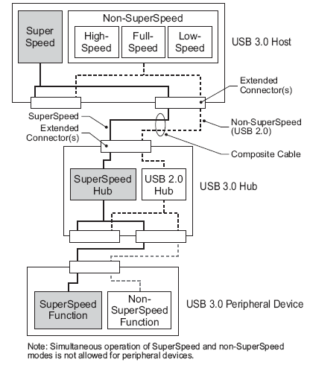
USB 3.0 Bus Architecture
Dual-bus architecture SuperSpeed bus operates concurrently with USB 2.0
Electrically/mechanically backward & forward compatible
Devices discovered/configured at fastest signaling rate
Hubs provide additional connection points
SuperSpeed USB
Dual simplex signaling
Packets routed to device
Hubs store and forward
Asynchronous notifications
4

Slide 5
SuperSpeed USB Layered Architecture
5
Notes:
USB 3.0 SuperSpeed is layered. The following foils will take a bottoms up approach to talk about the layers. At a high level, they will talk about what goes into each layer, what happens to it in that layer and finally what comes out.

Slide 6
USB 3.0 Connector & Cable Goals and objectives
6
Deliver low cost connectors and cable assemblies solutions to meet USB 3.0 architecture and performance needs
Support 5 Gbps data rate
Manage compatibility with USB 2.0
Minimize connector form factor variations
Contain EMI
Comprehend ease-of-use aspects

Slide 7
Connector interoperability summary
Receptacle | Plugs Accepted
USB 2.0 Standard-A | USB 2.0 Standard-A or USB 3.0 Standard-A
USB 3.0 Standard-A | USB 3.0 Standard-A or USB 2.0 Standard-A
USB 2.0 Standard-B | USB 2.0 Standard-B
USB 3.0 Standard-B | USB 3.0 Standard-B or USB 2.0 Standard-B
USB 3.0 Powered-B | USB 3.0 Powered-B, USB 3.0 Standard-B, or USB 2.0 Standard-B
USB 2.0 Micro-B | USB 2.0 Micro-B
USB 3.0 Micro-B | USB 3.0 Micro-B or USB 2.0 Micro-B
USB 2.0 Micro-AB | USB 2.0 Micro-B or USB 2.0 Micro-A
USB 3.0 Micro-AB | USB 3.0 Micro-B, USB 3.0 Micro-A, USB 2.0 Micro-B, or USB 2.0 Micro-A
7

Slide 8
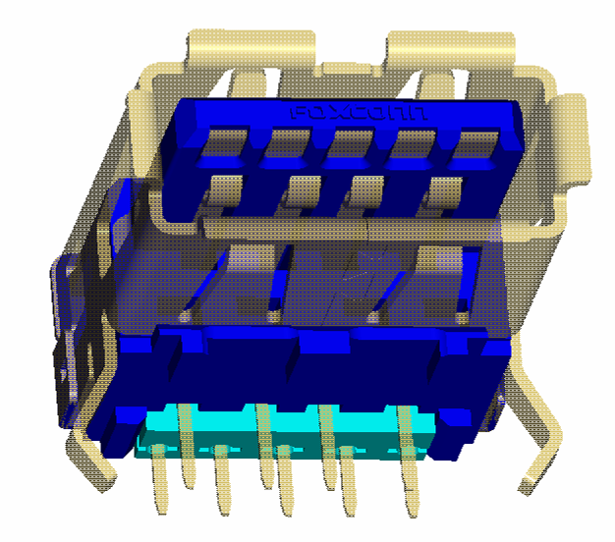
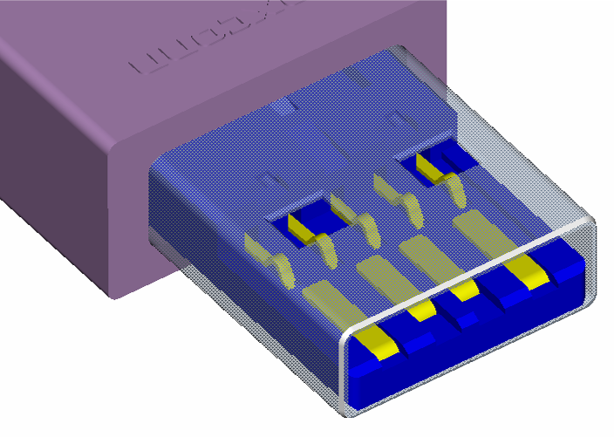
USB 3.0 Standard-A connector
Same interface as the USB 2.0 Standard-A connector, but with added pins for SuperSpeed USB signals
Complete compatibility with USB 2.0 Standard-A connector
Double-stacked connectors supported
USB3_RX
GND
USB3_TX
VBUS
D-
D+
GND
8

Slide 9
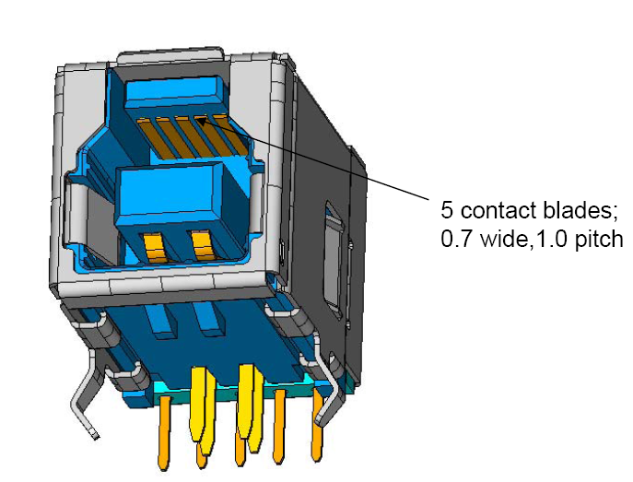
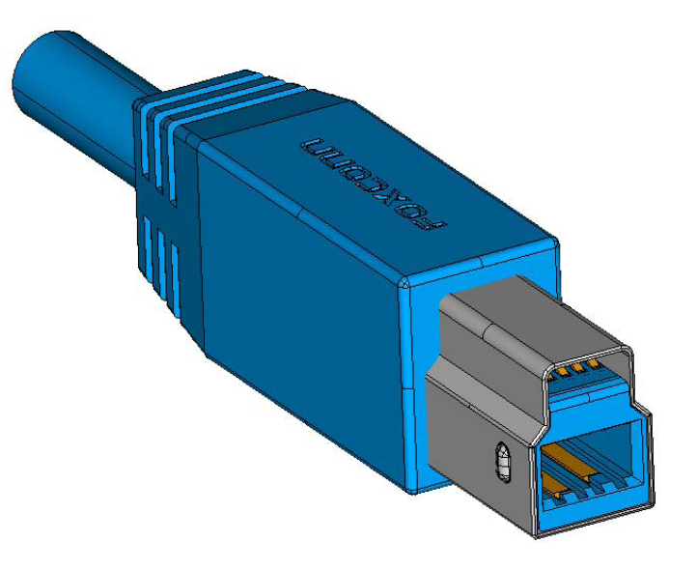
USB 3.0 Standard-B connector
Defined for relatively large, stationary peripherals such as hard drives and printers
Visually different from USB 2.0 Standard-B connector
But the receptacle accepts a USB 2.0 Standard-B plug
9

Slide 10
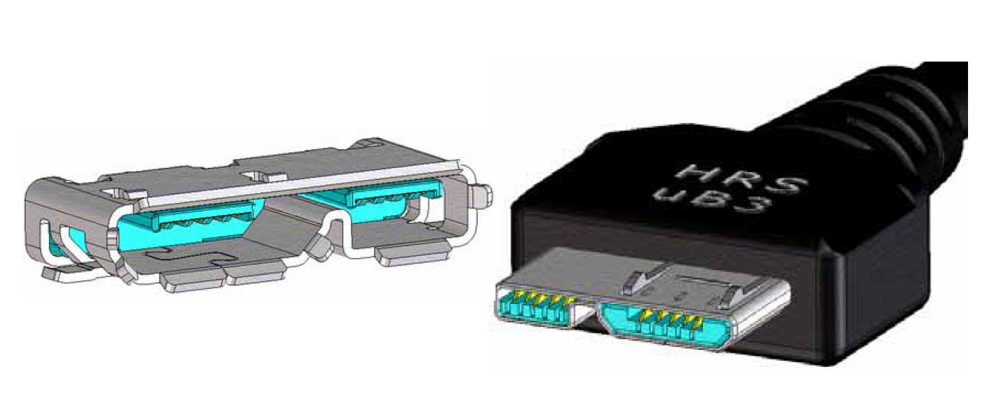
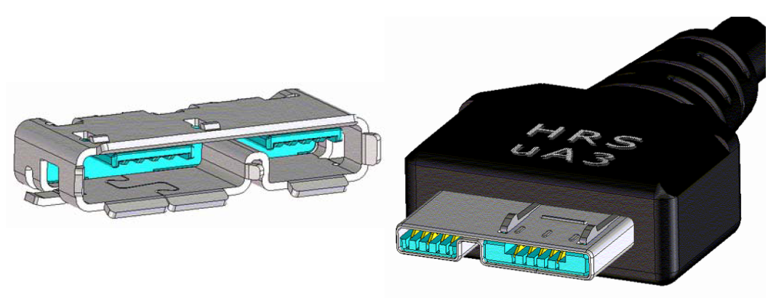
USB 3.0 Micro connector family
Defined for hand held devices
Backward compatible with USB 2.0 Micro connectors
Based on USB 2.0 Micro-B connector with an extended portion for the SuperSpeed USB signals
USB 3.0 Micro-A and –AB connectors are identical to USB 3.0 Micro-B connector except for different keying
USB 2.0
Portion
USB 3.0
Portion
Micro-B
Micro-AB/A
10

Slide 11
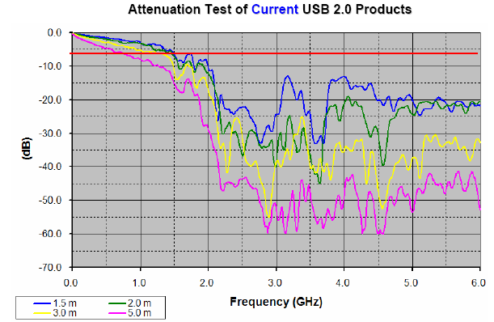
Cables
Unshielded twisted pair (UTP) cable used for USB 2.0 cannot be used for SuperSpeed USB
Shielded differential pair (SDP, twisted or twinax) is needed for SuperSpeed USB
Signal integrity and EMI containment
11

Slide 12
SuperSpeed USB Physical Layer
Symbols &
Sideband Signaling
12
Notes:
The PHY layer is responsible for taking in bytes (data or control) and putting them onto the wire. In the process, the 8-bit data is converted to a 10-bit symbol which is scrambled. The data clock is spread and the clock is encoded with the data. The spreading and scrambling are used to minimize EMI. A requirement for an external cabled connection. The receiver recovers the clock from the data and reverses the scrambling and 8b/10b encoding process to pass back data and control bytes to the link layer. In addition, the PHY has the ability to turn off the physical layer driver and even the data clock. It uses side-band signaling to get the links out of these reduced power states. It is don this way to minimize power when not moving data. This same side-band signaling also is used for remote wakeup and to reset the link.

Slide 13
Physical Layer
Support up to a 3 Meter cable
Based on existing specs
Signaling similar to mix of high-speed serial buses (PCIe/SATA)
2 differential pairs – dual simplex
Retain sideband functionality (e.g. reset, wake) without additional wires
Low Frequency Periodic Signaling (LFPS) – similar to PCIe beaconing
Retain USB Hot Plug functionality
Rx termination for connect/disconnect detect
13
Notes:
13
PCIe-like signaling w/ eSATA like spread clock / CDR
Major differences
SuperSpeed is not a common clock architecture
SuperSpeed requires spread spectrum on both sides
SuperSpeed requires Rx side equalization
Jitter budgeting
Clock jitter subsumed inside of Tx
Channel jitter is more random
No auxiliary pins for
Connect/disconnect detection
Link reset, PM state control, wake
Rx termination detection
Low Frequency Periodic Signaling (LFPS)

Slide 14
SuperSpeed USB Link Layer
Packets &
Link Cmds
14
Notes:
The link layer is responsible to take data from the protocol layer and package it up to send across the physical layer. It does this by making packets that are used for bus management, flow control and to move data. It also is responsible to endure that packet headers are moved reliably across the link. It appends header numbers and CRCs to ensure that the right header is received correctly. It is responsible to retry the header if not. It generates and interprets link commands to control the link PM state, frame packets etc. The USB 3.0 link is highly reliable – that is a packet with an undetected error is expected to get through only once every 400 years.

Slide 15
Link Layer
Robust & Reliable
Redundancy, advanced encoding techniques and retries
>10⁻²⁰ undetectable error rate for link commands
Effective Power Management
Four link power states
Either port can initiate link power state change
Low Frequency Periodic Signaling (LFPS)
Link Commands
Link flow control
Link power state change
Packets
Header Packets
Store and forward
Link level retries guarantee reliability
Contain information consumed by link or host or device
Data Packet
Compound packet contains header plus data payload
15
Notes:
15
Redundancy is used on the construction of link commands and framing so that any one corrupted or missing symbol can be tolerated with no impact.

Slide 16
SuperSpeed USB Protocol Layer
Headers &
Data
16
Notes:
The protocol layer gets transactions from the application layer to move blocks of data. It is responsible to break those requests into bite size pieces and give the pieces to the link layer to send. It is responsible to check that the received packets are good (e.g. CRC) and retry them in not. It is responsible for processing notifications, sending system information (LTMs), sending timestamp packets etc. The protocol is asynchronous – that is, the host initiates a transfer and the device may either accept it and do it then or may say it is not ready. In the latter case, the device asynchronously notifies the host when it is ready. The SuperSpeed protocol has introduces the notion of streams. This extension of the bulk protocol allows a device to support multiple commands on a pipe and to service them out of order. This feature was driven to support the needs of Mass Storage, but was defined generically so it may be used by other device classes.

Slide 17
Protocol Layer
Preserved legacy SW stack
USB 2.0 transfer types (bulk, control, interrupt, isochronous)
Streams enhance bulk’s capabilities
Multiple commands on a pipe
Out of order completion
Optimized for good power management
Routable Packet Architecture
Asynchronous notifications
Efficient use of bandwidth
Simultaneous IN / OUTs
17
Notes:
17
Backwards compatible with legacy SW stack
Routable – not broadcast
Asynch notifications - removes need to poll

Slide 18
Packet Basics
Header & Data Packets
Move between host and device
Address triple: device address, endpoint number, direction
Route String describes path between host and device
Host initiates ALL data transfers
Devices
Either respond immediately or defer the packet
Hubs proxy for target device by deferring packets routed to a downstream port whose link is not active
Deferred requests restarted asynchronously
Device notifies host which responds with a new transfer request
Bus active only when moving data
18

Slide 19
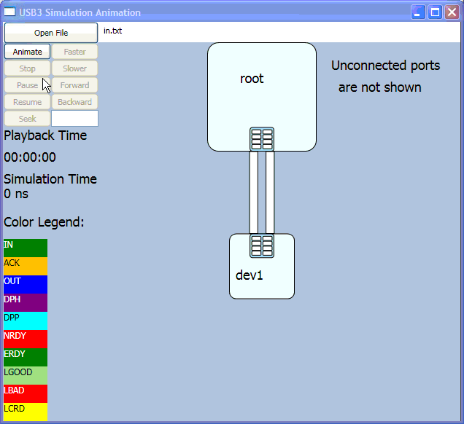
Example IN Transaction
19

Slide 20
SuperSpeed USB Application Layer
Same as USB 2.0
20
Notes:
The key here is that existing drivers will work. For example, there will be a demo today showing a Mass Storage device transferring data using the existing (unmodified) Windows Mass Storage driver. It should be noted that some device classes may be able to get better performance by using new capabilities of SuperSpeed such as simultaneous bi-directional transfers, streams etc.

Slide 21
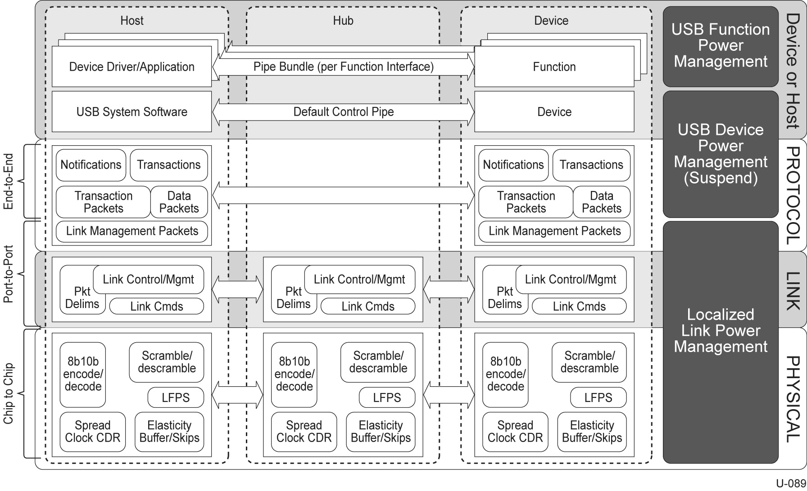
Power Management Overview

Slide 22
Power Management Overview
Power Management is at all levels
PHY layer, e.g. remote wakeup signaling
Link layer, e.g. low power link state entry & exit
Protocol layer, e.g. endpoint busy / ready notifications
Devices, e.g. function suspend
Hubs, e.g. “bubble up” link PM
Hosts, e.g. ping / ping response messaging
Power efficiency at system level
Async endpoint busy / ready notifications – no polling
Packets routed, not broadcast
Low power link states entered automatically when idle

Slide 23
SuperSpeed USB Power Management Primitives
Physical Layer
Lower power per bit
Dual simplex - don’t need to turn around the bus
Low Frequency Periodic Signaling
Link Layer
Four Link States - trade lower power for increased latency
U0: operational, U1: link idle with fast exit (PLL remains on)
U2: link idle with slow exit (PLL may be off), U3: suspend
Protocol Layer
Deferring & asynchronous device notifications
Packets Pending flag
Ping/Ping Response
Selective Suspend
Isochronous Timestamp packets
Latency Tolerance Message
23
Notes:
LFPS – always on even when link in U3. Lowest power solution to detect wake, bring up a link etc.
U0: operational, U1: link idle with fast exit (PLL remains on)
U2: link idle with slow exit (PLL may be off), U3: suspend
Controls data movement (ERDY/NRDY)
LTMs aid system to chose deepest state consistent with device
Ping/Ping-Response is used to wake a path for ISO transfers

Slide 24
SuperSpeed USB Hubs
SuperSpeed USB hubs are more than port expanders
Hubs central to SuperSpeed USB power management
A hub adjusts its upstream port link state based in its downstream ports’ link state
A hub routes a downstream flowing packet only to the specified port
A hub defers packets directed to ports whose links are not in the active state
A hub has programmable inactivity timers on its downstream ports
A hub only forwards multicast timestamp packets to downstream ports whose link is active
A hub marks timestamp packets that are delayed
24
Notes:
Link states controlled by devices and/or HW inactivity timers
Hubs propagate link state upstream - keeps fabric in lowest possible power state
Intermediate hubs return deferred notifications to host – minimize stalls
Isoch timing packets multicast only to links in U0
Devices control data movement (ERDY/NRDY)

Slide 25
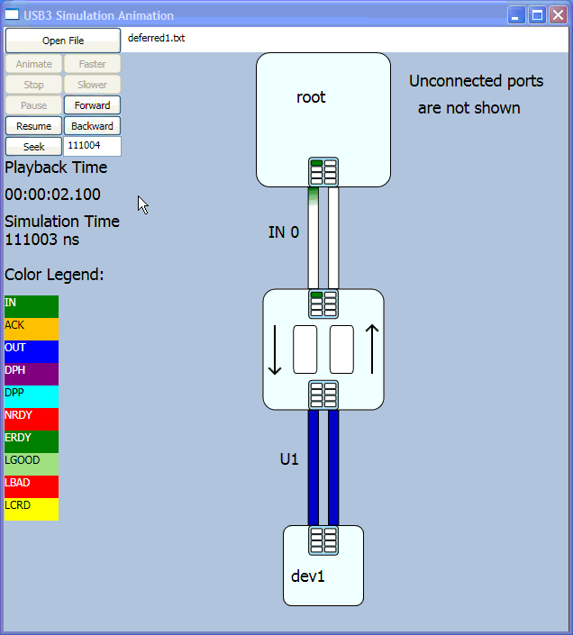
Simple Deferring Example
25
Notes:
Get rid of the words and turn into just a video with a voice over.

Slide 26
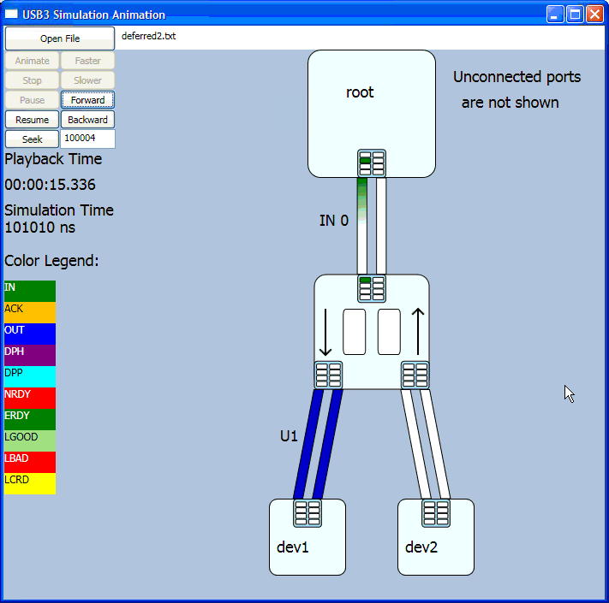
Deferring Balances Performance with Power Management
26
Notes:
Get rid of the words and turn into just a video with a voice over.

Slide 27
Host Support for Bus Power Management - Interrupt Endpoints
Interrupt transfers must get completed within service interval
Devices may use U1 / U2
Host sends transfer far enough ahead of time to compensate for worst case link exit latency
Host stops interrupt endpoint activity upon receipt of an NRDY
Resumes upon receipt of an ERDY
No polling – links can enter U1 / U2 when there is no activity
Notes:
Use here?
Refer to appropriate HC spec for how to tell host how far ahead of time to initiate transfer.

Slide 28
Host Support for Bus Power Management Isochronous Endpoints and Timestamp TPs
Isochronous transfers must get completed within service interval
Devices want to use U1 / U2 for improved power efficiency
Devices must comprehend U1 / U2 exit latencies
Ping / ping response messaging
Host sends a ping to isochronous device ahead of an isoch transfer
Gets all links in path to device back to U0 prior to transfer
Device responds with a ping response to host
Host then schedules isochronous transfer
Device keeps link in U0 until transfer occurs
Host can perform other transfers while waiting for ping response
Timestamp packets sent at bus interval boundaries
Only sent on downstream ports in U0
U1 / U2 link inactivity timers ignore timestamp packets
Notes:
Use Here?
Refer to appropriate HC spec for how to tell host how far ahead of time to send ping.

Slide 29
Function Suspend and Device Suspend
Function suspend
Individual functions* placed into function suspend independently
Controlled by FUNCTION_SUSPEND feature selector
Device suspend
Device-wide state coupled to U3
Entered / exited intrinsically as a result of U3 entry / exit
SetPortFeature(PORT_LINK_STATE U3)
Device suspend entered regardless of function suspend state
Selective suspend also supported
System software may initiate device suspend when all of a device’s functions are in function suspend
* Composite devices contain multiple functions
Notes:
Use here?”

Slide 30
SuperSpeed USB Power Management
Fine grain power management controlled by devices
Devices control their own link state
Host provides ‘packets pending transfer’ information to device
When no transfers are pending, devices can put their link into a reduced power management state
Hubs play key role
Propagate link state upwards
Forward packets only to the link in the direct path
Forward Isochronous Timestamp packets only to active links and do not effect inactivity timers
Default power management policy
Systems set by inactivity timers in downstream ports
30

Slide 31
System Level Power Management Latency Tolerance Messaging
LTM enables system to enter deeper power saving states with cooperation of devices
Devices report the latency they can tolerate from the system in response to a request
Send host LTM notification packet with latency value
Allows system to enter deeper sleep states when devices in system can tolerate it

Slide 32
SuperSpeed USB Updates to the Specification
Same as USB 2.0
32

Slide 33
Summary
Physical layer is based on existing industry specs
Maintained backwards compatibility
Cabling/connector
Standard A receptacles backward compatible with USB 2.0
New B and Micro AB receptacles backward compatible with USB 2.0
Devices – USB 2.0 support remains
Software – Existing device drivers just work
Hubs support both USB 2.0 & SuperSpeed USB devices
Link and Protocol optimized for Power Management
U0-U3 link states
Devices drive own link state, hubs propagate up
Deferring and asynchronous notifications maximize opportunities for PM
Hub inactivity timers provide coarser, but effective default PM
33

Slide 34
Call to Action
Download & Review USB 3.0 Material
Updated USB 3.0 Version 1.0 Specification
Referenced documents
Pipe Spec (www.developers.intel.com)
Device Link Power Management is a requirement
34
Notes:
Pipe & xHCI
IF help promote, early access to integration lab, get tricks learned from our experiences
Early access to peripheral integration lab

